Slide 1
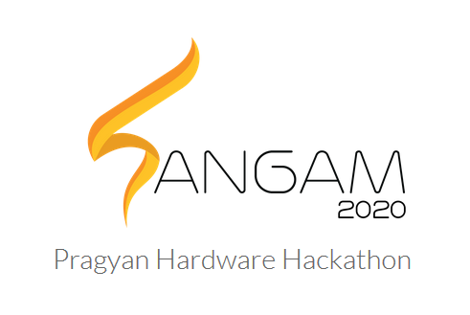


marko
Machine Assisted Rehabilitation for Knee OsteoArthrits

Slide 2
aim
MARKO is a continuous passive motion(CPM) machine aimed at providing a cheap and affordable solution for patients suffering from knee osteoarthiritis.

Slide 3
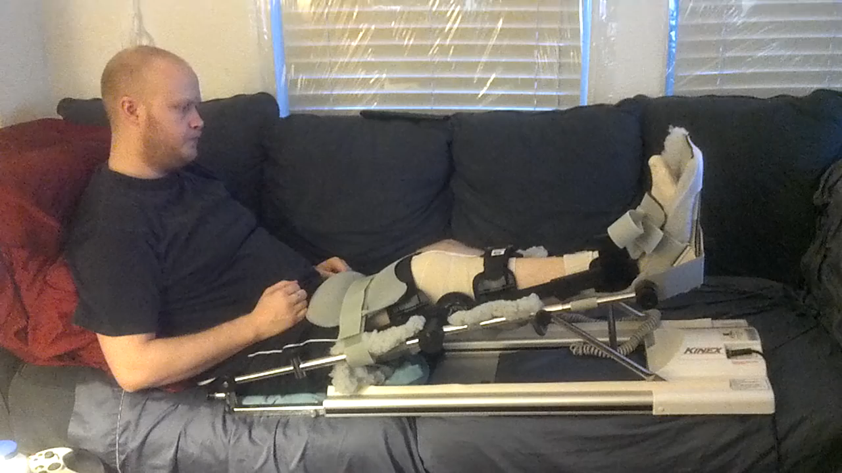
Existing cpm machine in use

Slide 4
MARKO – One of a kind robotic therapeutic tool (CPM) which aims to:
Bridges the gap between therapy (stage 1) and training (stage 2 ).
Cuts down the lengthy recovery process and huge expenditure involved in frequent consultations.
Be an one time investment.
Makes the recovery process motivating and interesting.
Easier to use (even in case of bedridden patients).

Slide 5
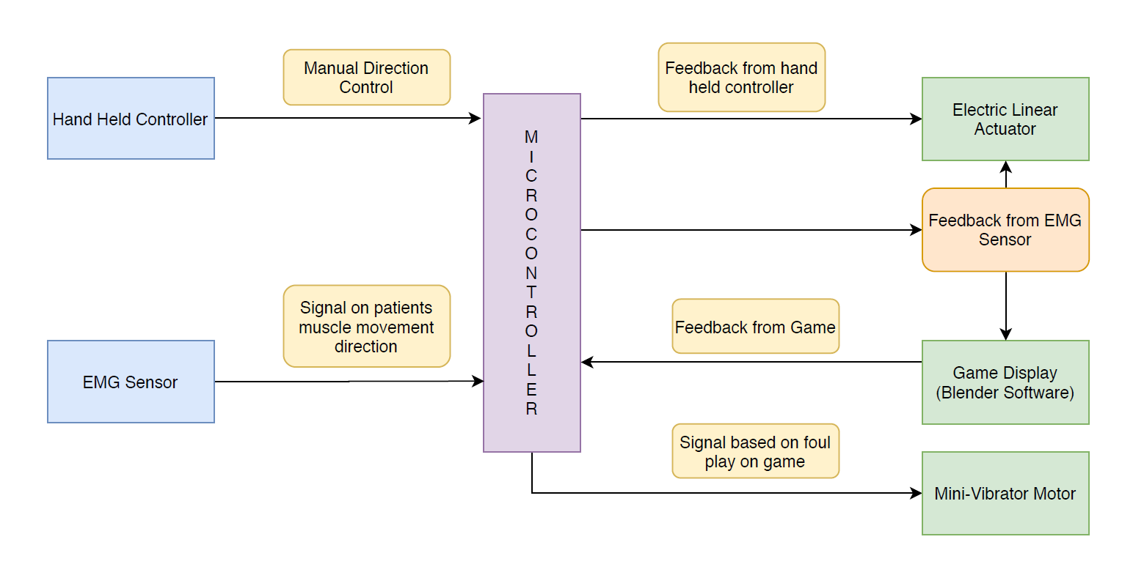
Block diagram

Slide 6
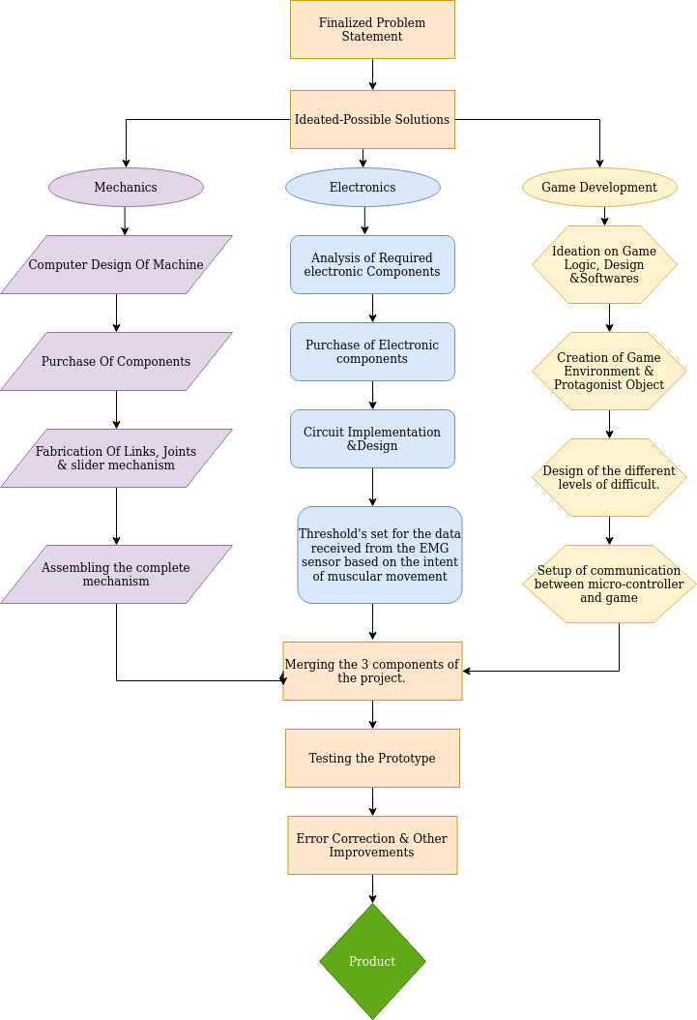

Slide 7
PROGRESS
MECHANICS
ELECTRONICS
GAME DEVELOPMENT

Slide 8
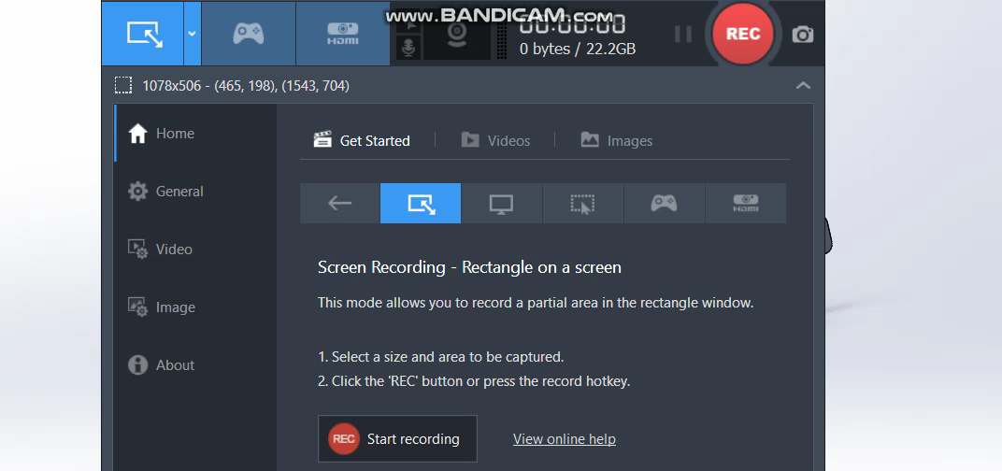
MECHANICS - Solidworks DESIGN

Slide 9
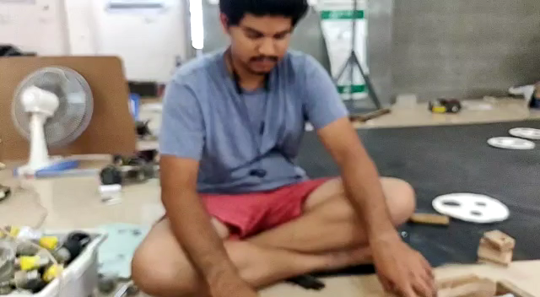
Real TIME EXPLANATION

Slide 10
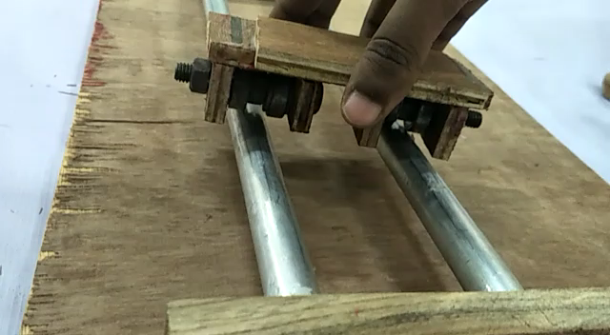
SLIDER MOVEMENT

Slide 11
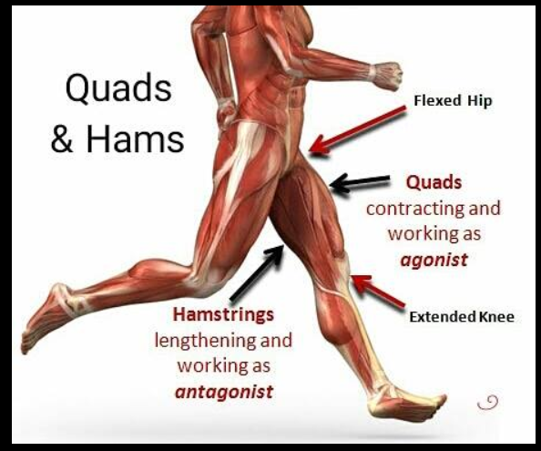
Electronics (muscles involved)
Hamstrings and
Quadriceps

Slide 12
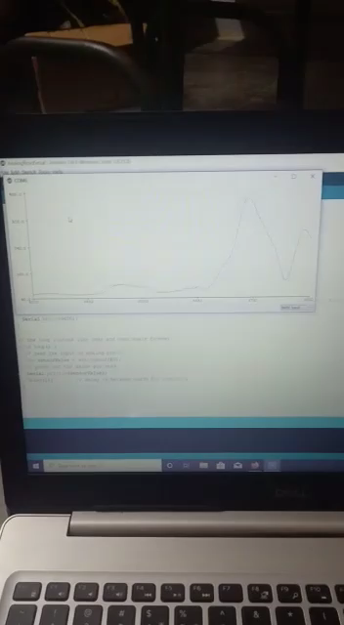
EMG INTENT ESTIMATION

Slide 13
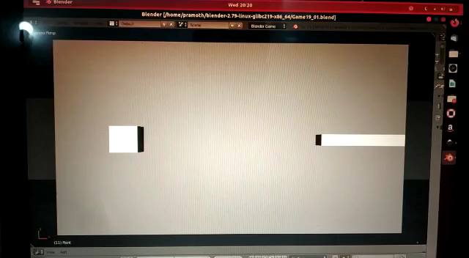
Game interface (blender)

Slide 14
ESTIMATED cost
Fabrication components : INR 2000/-
(wood , hinges ,chains , ball bearings, etc….)
Motor and Motor driver : INR 5500/-
2 EMG sensors : INR 5500/-
Miscellaneous Electronics : INR 1000/-
(Arduino, buttons, vibrator motor, wires, etc…)
TOTAL COST: INR 14000/_

Slide 15
RESULT OF OUR INNOVATION
Cost Factor
Design Factor
Application Factor
Have cut down the cost and it is a one time investment for the complete recovery
Have made a CPM with a new design based on minimum force on knee joint
Have made a Bi-functional device with add-ons making the recovery period better for the users

Slide 16
What’s next ?
We are planning to introduce the concept on Machine Learning (ML), to estimate the accurate threshold value of the EMG sensors to detect the intent of the patient to move his legs.
Improvising the game in terms of graphics, number of levels, difficulty and inclusion of moving obstacles.
Integrating stage 1 and stage 2 together.
Testing the device and correcting the errors.

